Slide 1
Comparative Adjectives
Team members:
Билошицкий Михаил Владимирович
Котовщиков Андрей Романович
Смирнов Игорь Евгеньевич

Slide 2
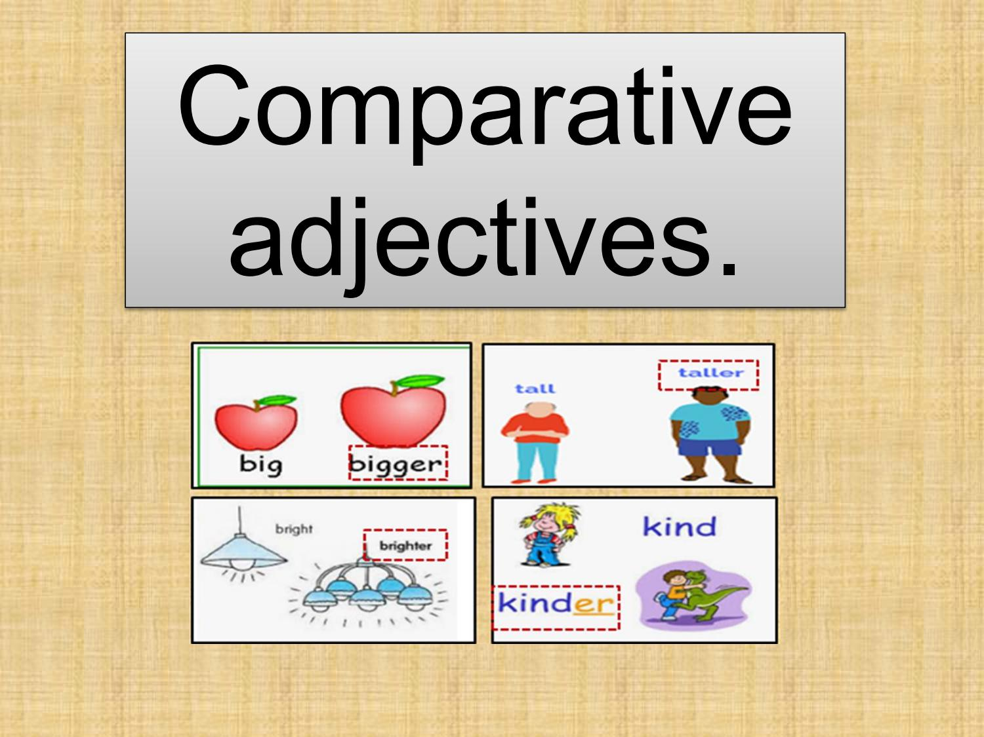
Usage Comparative Adjectives
Comparative adjectives are used to compare two things in English. They are formed by adding -er to the end of the adjective, or by adding the word "more" before the adjective.
When using comparative adjectives, it is important to make sure that the two things being compared are similar in some way. For example, you can't say "John is taller than the book," because John and the book are not comparable.
Additionally, there are some irregular comparative adjectives in English, such as "good" (which becomes "better") and "bad" (which becomes "worse").
Finally, it's important to note that when comparing three or more things, you use the superlative form of the adjective instead of the comparative form.

Slide 3
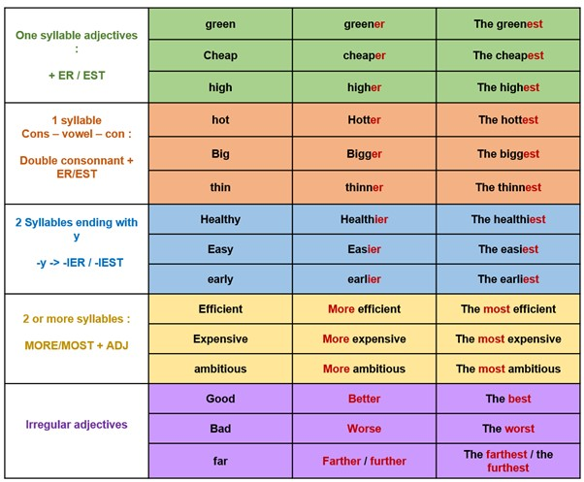
Construction

Slide 4

- The red car is faster than the blue car.
- The movie was more exciting than I expected.
- She is kinder than her brother.
- This restaurant is cheaper than the one next door.
- His work is less impressive than hers.
- The weather in Hawaii is warmer than in Alaska.
- My new laptop is better than my old one.
- The coffee at this shop is stronger than at the other one.
- Your hair is longer than mine.
- Her dress is prettier than yours.

Slide 5
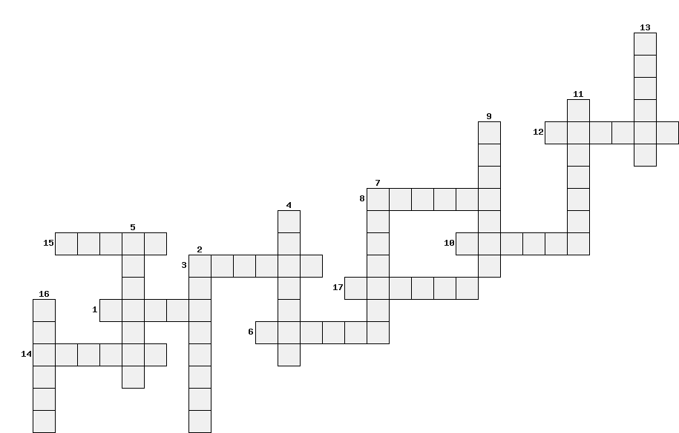
Game
Words:
Solve the crossword puzzle of 17 comparative words
1. Old
2. Strong
3. Sad
4. Cheap
5. Small
6. Good
7. Happy
8. Hot
9. Short
10. Weak
11. Young
12. Cold
13. Tall
14. Slow
15. Bad
16. Fast
17. Big

Slide 6
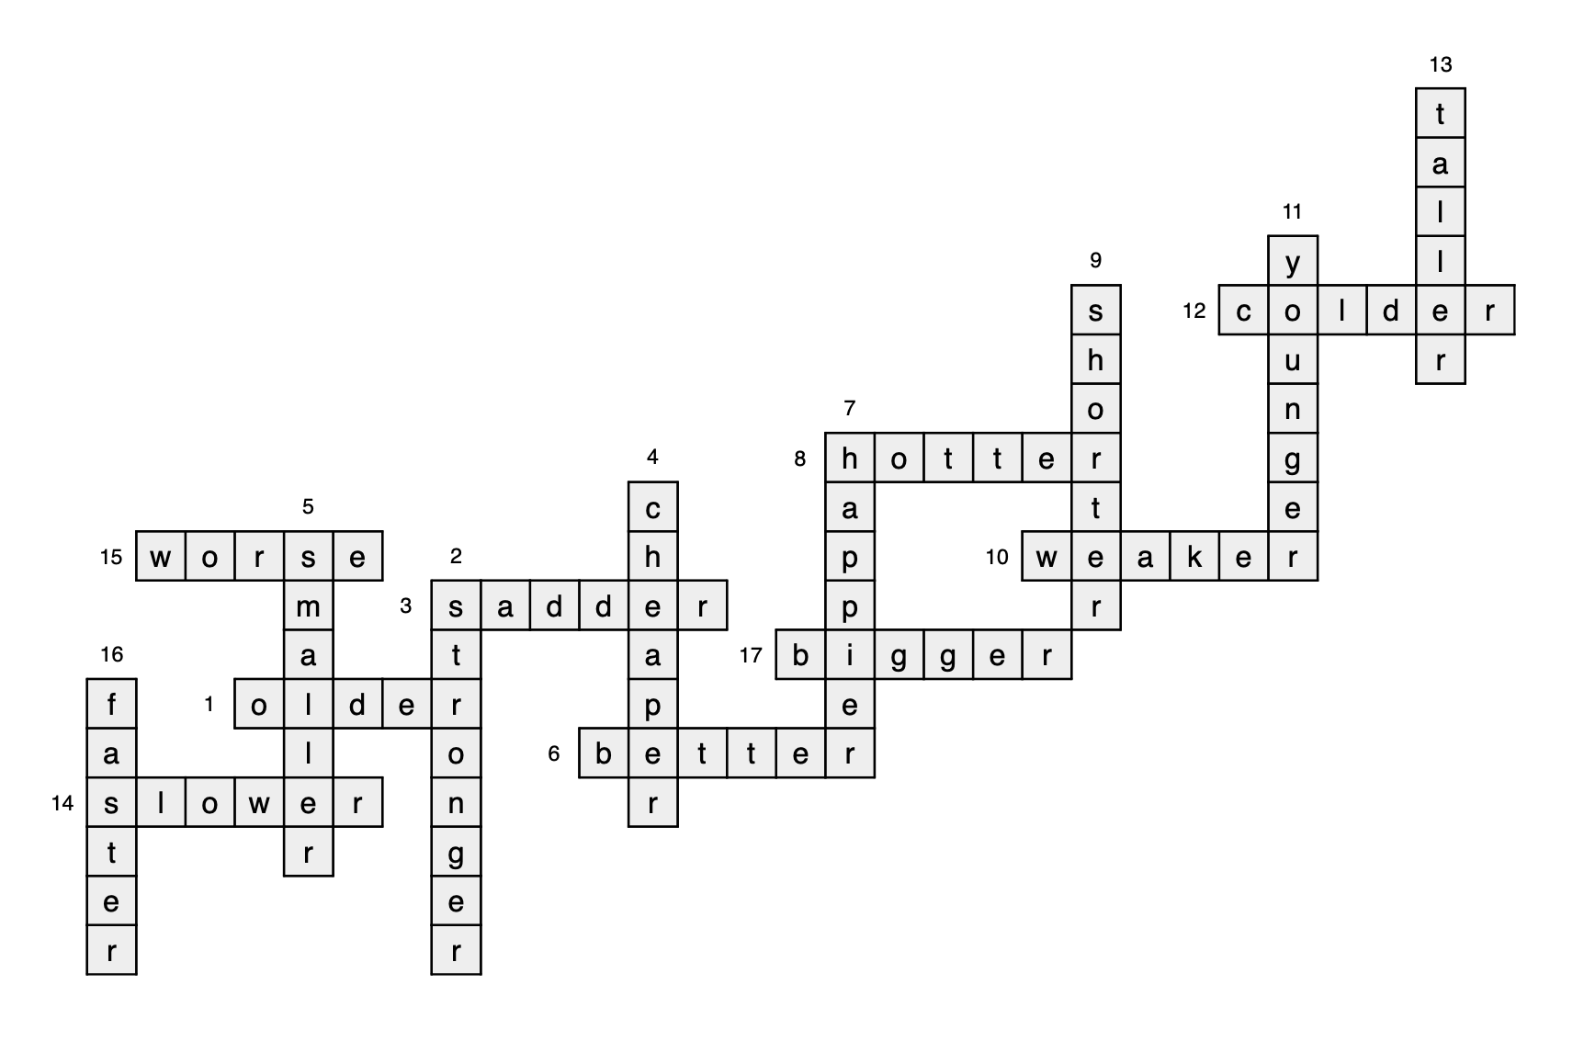
Game Solution

